Slide 1
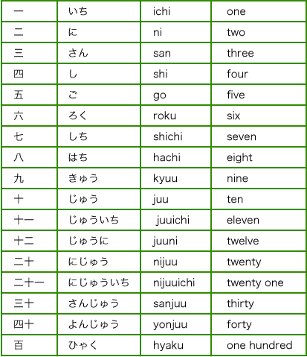
Numbers
.

Slide 2
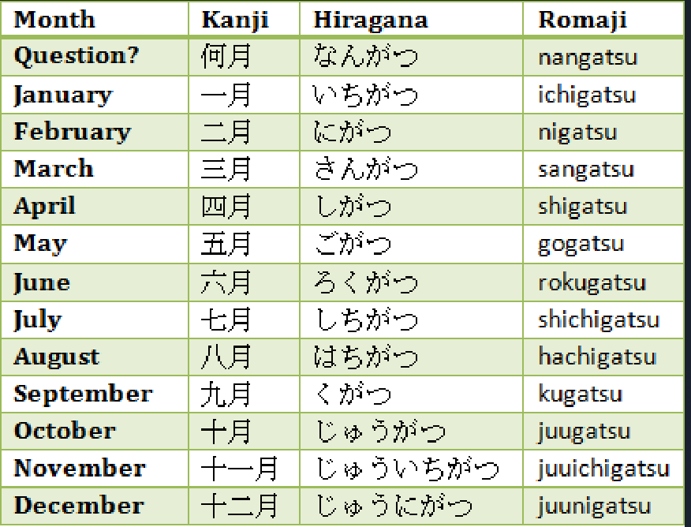
Months In Japanese

Slide 3
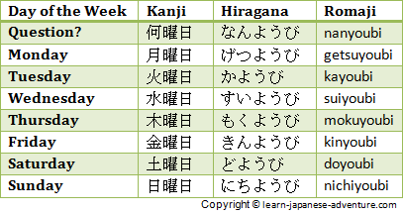
Days Of The Week In Japanese

Slide 4
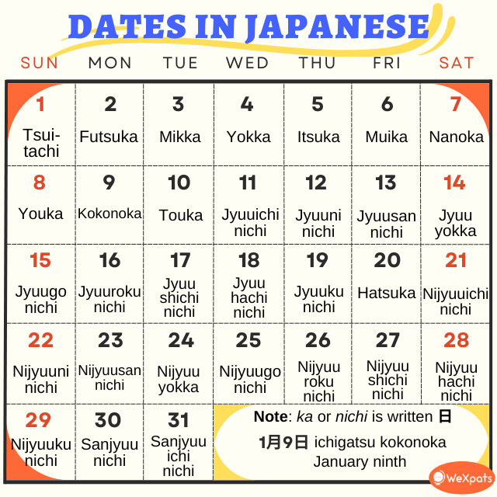

Slide 5
Numbers
Kanji 一 | English One | Romaji ichi, itsu
二 | Two | ni
三 | Three | san
四 | Four | Shi/YON
五 | Five | go
六 | Six | roku
七 | Seven | Shichi/NANA
八 | Eight | hachi
九 | Nine | kyuu, ku
十 | Ten | juu,
百 | Hundred | hyaku
千 | Thousand | sen
万 | Ten thousand | man, ban
円 | Yen, circle, and round | en

